Slide 1
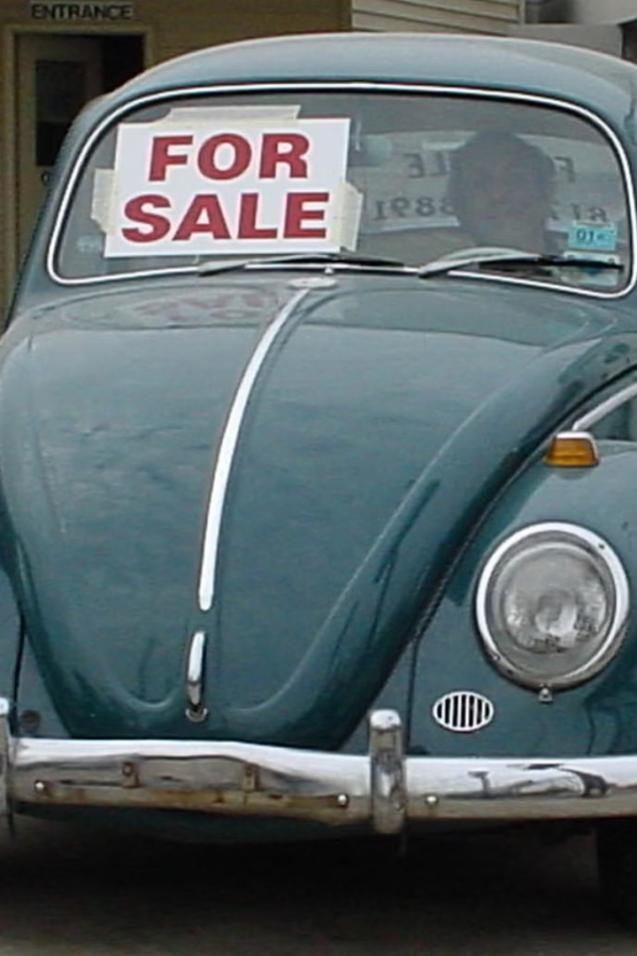

Car Sales Prediction
This project focuses on predicting used car sales prices. Prices can fluctuate wildly based on a variety of factors including the make and model of the car, its mileage, its condition and the current market conditions. As a result, it can be difficult for sellers to accurately price their cars. By leveraging data analysis and machine learning techniques, we aim to develop a reliable model for predicting the prices of used cars.

Slide 2


Car Dekho
CarDekho, an online platform that provides information related to new and used cars, was founded by siblings Amit Jain and Anurag Jain.
Amit Jain and Anurag Jain are Indian entrepreneurs who started CarDekho with the aim of simplifying the process of buying and selling cars in India. The platform offers a comprehensive database of cars, reviews, and related information to assist users in making informed decisions about purchasing or selling vehicles.

Slide 3
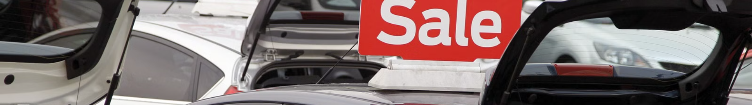
Problem statement: Predicting used car sales prices
1
Challenges in Price Prediction
Predicting the prices of used cars accurately is complex due to various factors like brand value, mileage, condition, and market demand.
2
Data Acquisition
Gathering reliable and comprehensive data on past sales is crucial for building a robust predictive model.Here we have collected data Online source named as the Car Dekho.com where prices of all cars will be available.
3
Market Volatility
The dynamic nature of the used car market presents challenges in predicting prices accurately over time. Prices can fluctuate wildly based on a variety of factors including the make and model of the car, its mileage, its condition and the current market conditions

Slide 4
Workflow:-
START
DATASET COLLECTION
EXPLORING FEATURES
EDA
HYPOTHESIS TESTING
FINALIZED MODEL
EVALUATION METRICS
MODEL BUILDING
DATA PREPROCESSING

Slide 5

Tools and Technologies Covered
The project utilizes advanced tools such as Tableau and Power BI for seamless data integration and interactive dashboard design. Additionally, Python libraries for machine learning and data analysis are essential for model development.
Jupyter Notebook: - It is a server client application that allows editing and running notebook documents via web browser, it does not require any internet access.

Slide 6
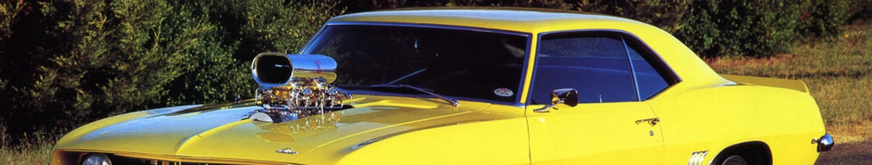
Data collection and preprocessing
Data Sources
Data Cleaning
Encoding
The Data has been Collected From the website named Car dekho.com where we have all the details about the car.
Dealing with missing values, and cleaning the object data formats to prepare the data analysis
Encoding The categorical values to numerical values and making it ready for the Model Building.Here we have Used Pandas Get dummies Function.

Slide 7

Feature engineering and selection
1
Feature Engineering
2
Correlation Analysis
3
Dimensionality Reduction
Creating new features from existing data to enhance the predictive power of the model.
Evaluating the relationships between different features and the target variable to select the most influential ones.
Dropping the unwanted Features from the dataset and dropping the correlated features in the dataset.

Slide 8




Model selection and evaluation
Model Selection
Cross-Validation
Evaluation Metrics
Exploring various models including linear regression, decision trees, and ensemble methods to identify the best fit for the data.
Using cross-validation technique to ensure the selected model's robustness and prevent overfitting.
Assessing model performance using metrics like mean absolute error (MAE) and root mean square error (RMSE).

Slide 9

Results and analysis
Insights from Results
Visualizations
Comparative Analysis
Creating visual representations like scatter plots and predictive distribution plots to communicate the findings effectively.
Comparing the predicted prices with actual sales records to understand the model's performance and accuracy.
Analyzing the model's predictions to gain insights into the market trends and factors influencing used car prices.

Slide 10
Model Performances
MODEL R2_ Score MAE RMSE
Linear Regression 0.8914139609505269 114720.348816654 219014.14715628768 Decision Tree 0.9487063131314817 118376.78241210282 182589.92132936168 Random Forest 0.9925213192197779 26553.282456141045 69719.99406731571

Slide 11

Risks and challenges
In this project, I encountered several notable challenges that added complexity to the analysis. Here dataset consist 8128 rows and 12 columns. Since this is the real time dataset, so Exploratory Data analysis has taken time. Additionally, the need for extensive feature engineering emerged as a significant hurdle. With the dataset requiring a deeper level of understanding, I found myself creating multiple columns derived from a single variable. While this approach provided a more nuanced perspective, extracting meaningful insights and knowledge from these new features proved to be intricate. Models has overfitten in tree models choosing correct parameters to avoid the over fitting problem is the Other challenge.I have Overcome all this challenges with extensive research on the data in the Internet.

Slide 12
Conclusion and Future Directions for Car Dekho Sales Prediction
1
2
3
Optimization
Innovation
Adaptation
Maximizing sales through improved inventory management and targeted marketing strategies.
Exploring novel data sources and advanced AI techniques for enhanced predictive capabilities.
Adjusting models in response to changing market dynamics and consumer preferences.

